Slide 1
GenAI models as keyword rankers: A learner-centred case study for L2 Spanish
department of translation, interpreting and communication
research groupS LT³ and MULTIPLES
Jasper Degraeuwe – 11 December 2025 – AILLTE Symposium
The Multifaceted Role of Generative AI in Transforming Language Learning and Teacher Education

Slide 2
About me
Ghent University (Belgium)
PhD on Intelligent Computer-Assisted Language Learning (ICALL)
ICALL ≈ CALL + AI and NLP
Postdoctoral researcher on educational technologies and AI for language learning
Notes:
[text]

Slide 3
Sneak peek
Notes:
[text]

Slide 4
Sneak peek
Language learning resources
Thematically organised vocabulary lists
Notes:
[text]

Slide 5
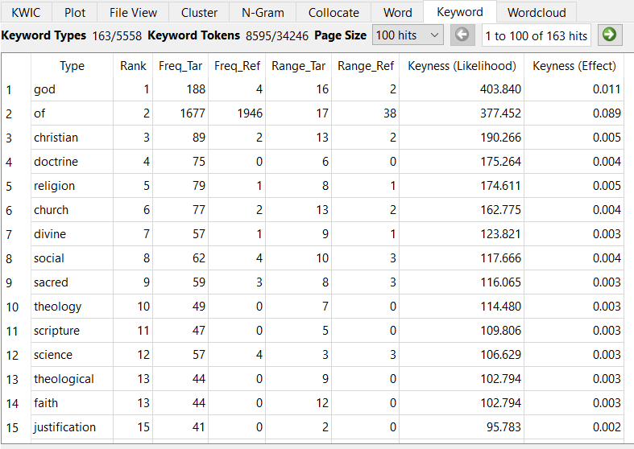
Source: AntConc
Notes:
Word list for a given domain, in this case religion.

Slide 6
Sneak peek
Language learning resources
Thematically organised vocabulary lists
Three-way comparison
Human ranking (“gold standard”)
Ranking based on statistical “keyness” method
GenAI-based ranking
Notes:
[text]

Slide 7
Target setting
Notes:
[text]

Slide 8
Second language acquisition (SLA)
Notes:
[text]

Slide 9





=
=
Notes:
So, in other words
Machine replacing the human in the foreign language: no
Machine helping the human to learn how to speak the foreign language: yes

Slide 10
Research question
Notes:
So, with that computer-assisted approach in mind, let’s have a look at the research question.

Slide 11

Research question
Are GenAI models able to rank vocabulary items according to their keyness (i.e. typicality) for a given semantic domain?
Notes:
[text]

Slide 12
Real-life utility

Slide 13
Target users
Educational setting
Language learners
Language teachers
Especially in language for specific purposes setting
Professional setting
Language professionals (e.g., interpreters)

Slide 14
Scenario A: background
Teacher
Preparation of vocabulary class
Topic: music
Notes:
Let’s start with scenario A. Suppose I’m a teacher of English as a foreign language, and I’m preparing a vocabulary class on the topic of music.

Slide 15
Scenario A: Gather texts
Notes:
First thing I do is gathering texts on the topic.

Slide 16
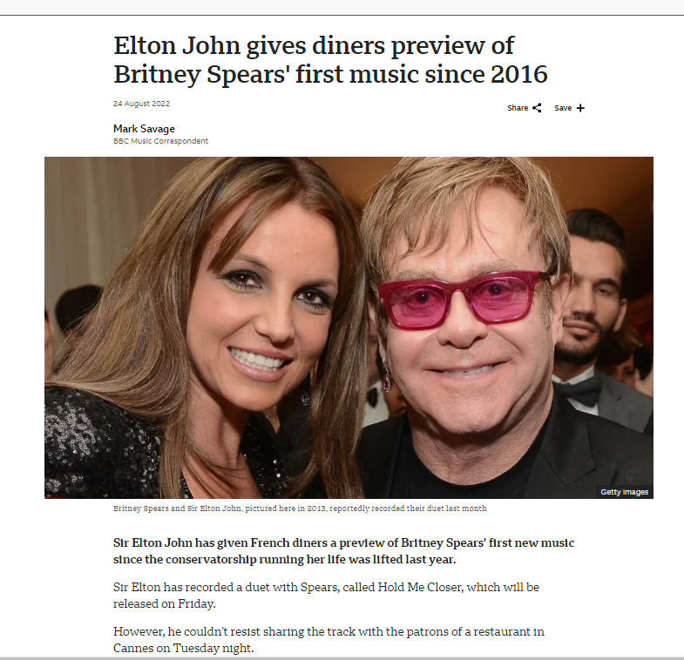
Notes:
I go online and start looking for articles.

Slide 17
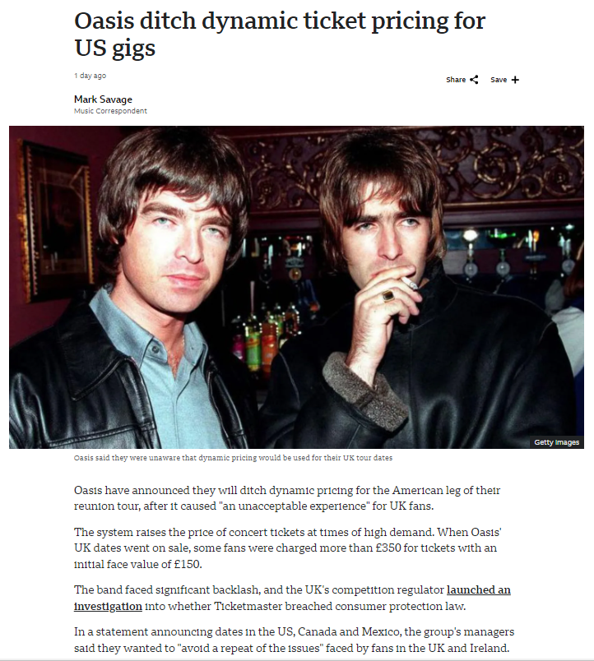
Notes:
A

Slide 18
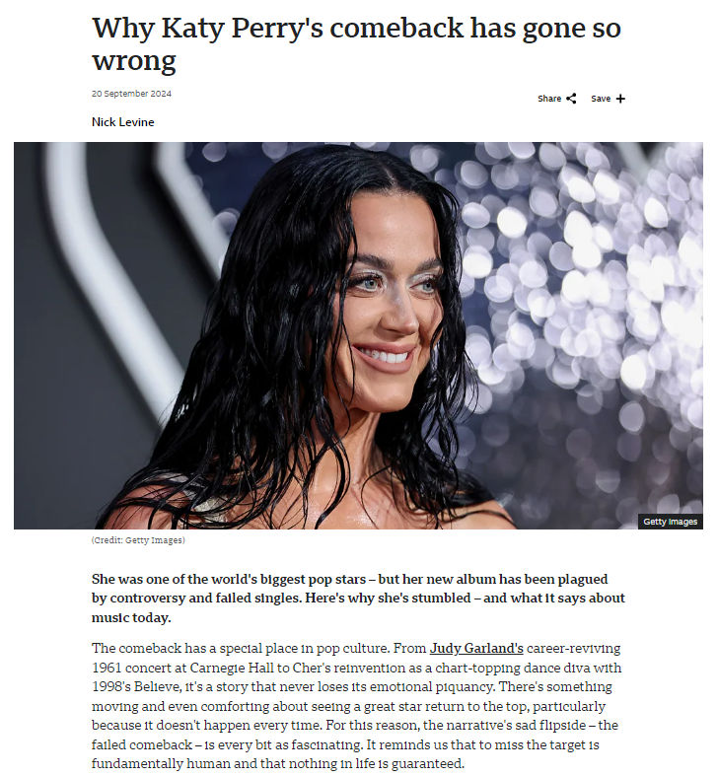
Notes:
lot

Slide 19
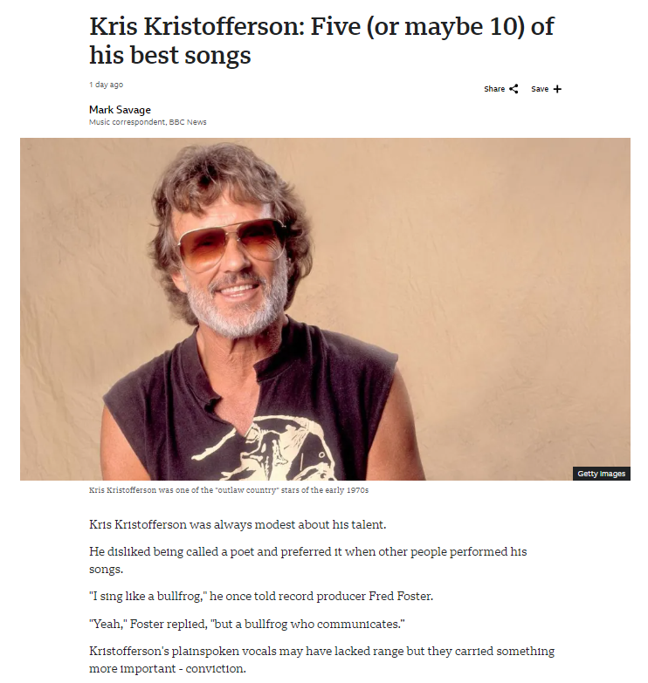
Notes:
of

Slide 20
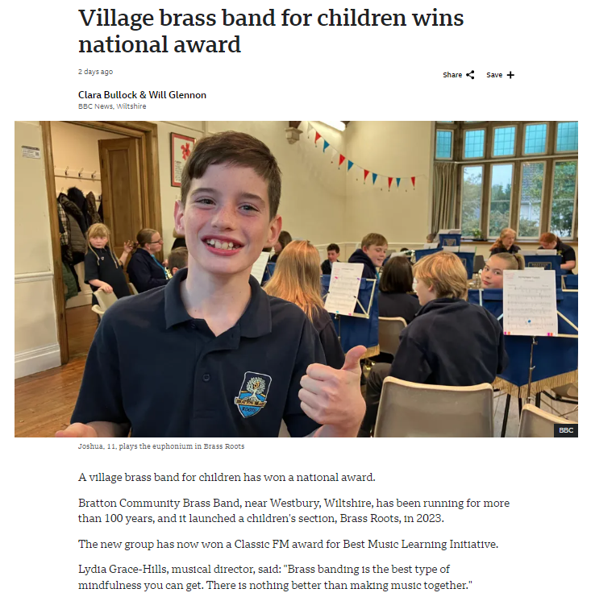
Notes:
articles

Slide 21
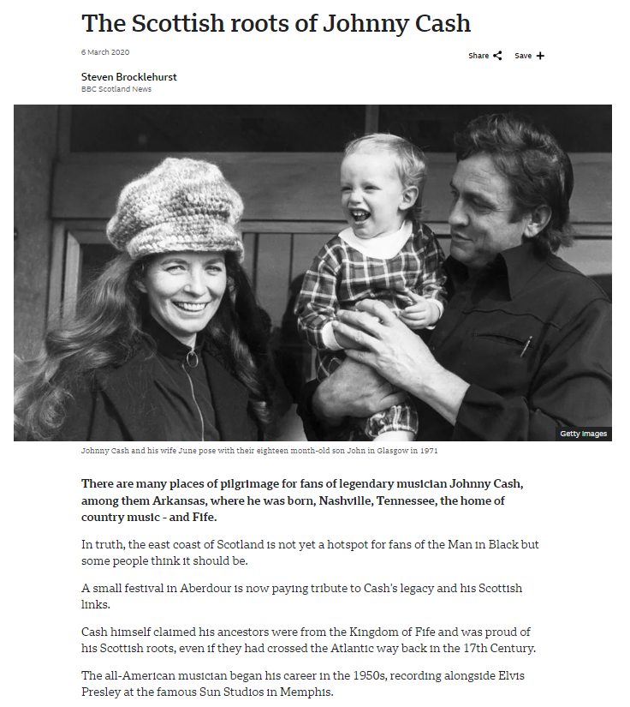
Notes:
At a certain point, I feel I’ve gathered enough texts, […]

Slide 22
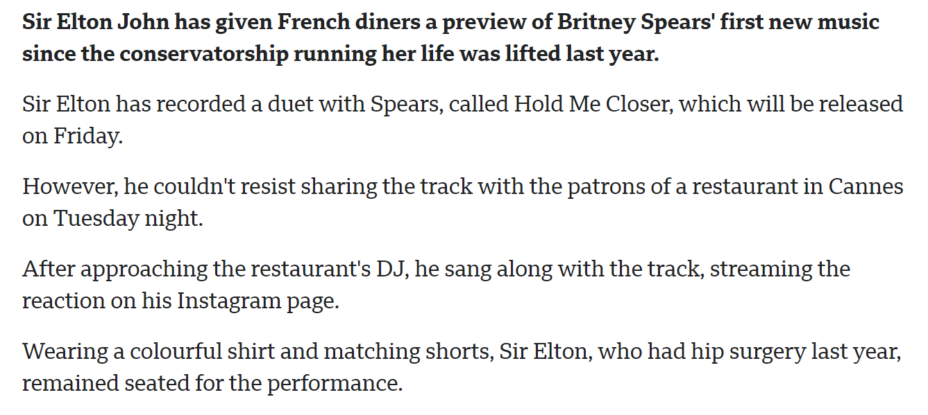
Scenario A: Read and analyse texts
Notes:
[…] so I start to actually read them.

Slide 23
Scenario A: Read and analyse texts
Notes:
And while I’m reading them, I highlight all relevant words. Words related to music.

Slide 24
Scenario A: Read and analyse texts
Notes:
Other words I just skip, because they’re not relevant to teach here.

Slide 25


Scenario A: pros and cons
Teacher expertise
Authentic input data (articles)
→ Very qualitative
Very time-consuming
Notes:
So in summary, this approach will result in high-quality learning materials because it combines the expertise of a teacher with authentic input data.
But it has the disadvantage that it takes an awful lot of time: gathering, reading and analysing dozens of articles is not something you do during a lunch break. And let’s not forget that this is all preparation stuff, the teacher still needs give the class, guide the students, correct their answers, give feedback as well.

Slide 26
Scenario B: GenAI assistance
Prompt: “please give me a list of the n most typical words of the domain of music”
Introduce prompt into GenAI model
Notes:
A little help from an artificial friend!

Slide 27
Scenario B: pros and cons
Advantages: very quick
Disadvantages: no evidence if output corresponds to established knowledge / human intuition

Slide 28
Research time!
Notes:
[text]

Slide 29
Methodology
Notes:
[text]

Slide 30
Data collection (1)
Target language = L2 Spanish
Four specific topics: economics, health, law, and migration
Data source: Spanish Corpus Annotation Project (scap.ugent.be)
Specialised newspaper-article corpora
Large general reference corpus

Slide 31
Data collection (2)
Create list of 200 vocabulary items for each topic (random stratified sampling)
50 frequent + key items: high SC frequency and higher (normalised) frequency than in RC
50 frequent + “non-key” items: high SC frequency and lower frequency than in RC
50 infrequent + key items: low SC frequency and higher frequency than in RC
50 infrequent + “non-key” items: low SC frequency and lower frequency than in RC
SC = specialised study corpus | RC = general reference corpus
Notes:
[text]

Slide 32
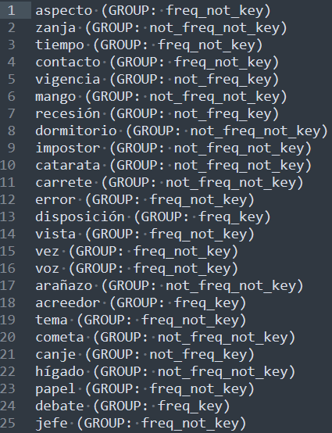
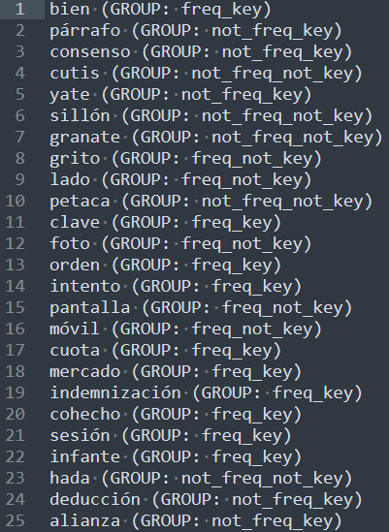
Data collection (3)
economics
law
…
Notes:
[text]

Slide 33
Sneak peek
Language learning resources
Thematically organised vocabulary lists
Three-way comparison
Human ranking (“gold standard”)
Ranking based on statistical “keyness” method
GenAI-based ranking
Notes:
[text]

Slide 34
Ranking 1 – Human ranking
Best-worst scaling experiment
Participants: six L2 Spanish learners (L1 = Dutch)
Notes:
[text]

Slide 35
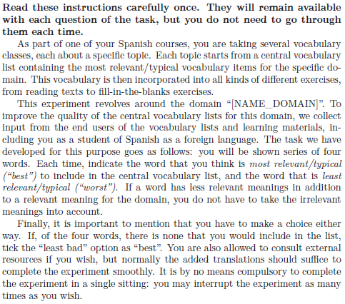
Ranking 1 – Human ranking
Notes:
[text]

Slide 36
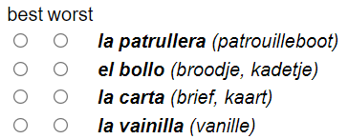
Ranking 1 – Human ranking
Notes:
[text]

Slide 37
Ranking 1 – Human ranking
Best-worst scaling experiment
Participants: six L2 Spanish learners (L1 = Dutch)
Each of the 200 items was compared to three other words in eight unique 4-tuples
Each tuple was annotated by three different L2 learners
→ 8 x 3 = 24 “typicality comparisons” / vocabulary item
Notes:
[text]

Slide 38
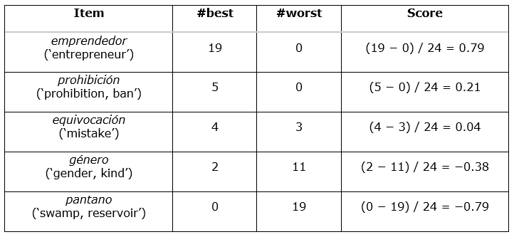
Ranking 1 – Human ranking
“Counting procedure” (Flynn & Marley, 2014)
Notes:
[text]

Slide 39
Overview rankings
Word | Human ranking | Baseline ranking (DKL) | GenAI-based ranking
entrepreneur | 14.5 (0.79)
prohibition, ban | 68 (0.21)
mistake | 91.5 (0.04)
gender, kind | 147.5 (-0.38)
swamp, reservoir | 189 (-0.79)
Notes:
[text]

Slide 40
Ranking 2 – Statistical measure (DKL)
Kullback-Leibler divergence (DKL)
Statistical measure from information theory that can be used to compare frequencies from two corpora (Gries, 2021)
Serves as “baseline” ranking
Notes:
[text]

Slide 41
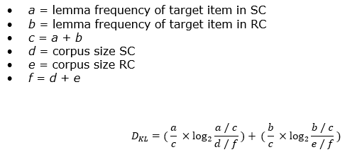
Ranking 2 – Statistical measure (DKL)
Notes:
[text]

Slide 42
Overview rankings
Word | Human ranking | Baseline ranking (DKL) | GenAI-based ranking
entrepreneur | 14.5 (0.79) | 19 (2.58)
prohibition, ban | 68 (0.21) | 66 (0.60)
mistake | 91.5 (0.04) | 175 (-0.09)
gender, kind | 147.5 (-0.38) | 88 (0.05)
swamp, reservoir | 189 (-0.79) | 168 (-0.08)
Notes:
[text]

Slide 43
Ranking 3 – GenAI-based ranking
Three “lightweight” open-source models tested: Gemma-3-4b (Google), Llama-3.1-8B (Meta), and Ministral-8B (Mistral)
Exact same task as given to humans: best-worst scaling
Notes:
[text]

Slide 44
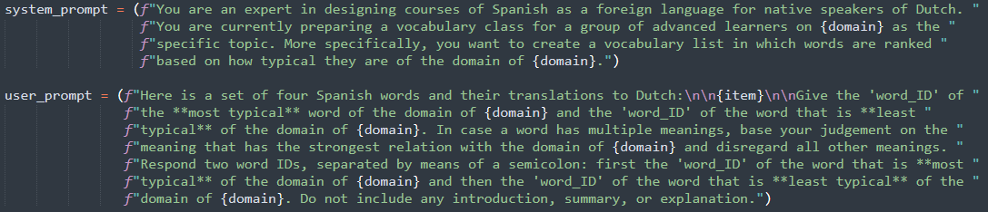
Ranking 3 – GenAI-based ranking
Notes:
[text]

Slide 45
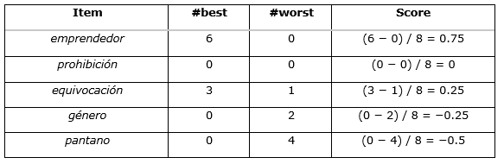
Ranking 3 – GenAI-based ranking
Notes:
[text]

Slide 46
Overview rankings
Word | Human ranking | Baseline ranking (DKL) | GenAI-based ranking
entrepreneur | 14.5 (0.79) | 19 (2.58) | 12 (0.75)
prohibition, ban | 68 (0.21) | 66 (0.60) | 99.5 (0)
mistake | 91.5 (0.04) | 175 (-0.09) | 62.5 (0.25)
gender, kind | 147.5 (-0.38) | 88 (0.05) | 135 (-0.25)
swamp, reservoir | 189 (-0.79) | 168 (-0.08) | 172 (-0.05)
Notes:
[text]

Slide 47
Analysis: correlation between rankings
Notes:
[text]

Slide 48
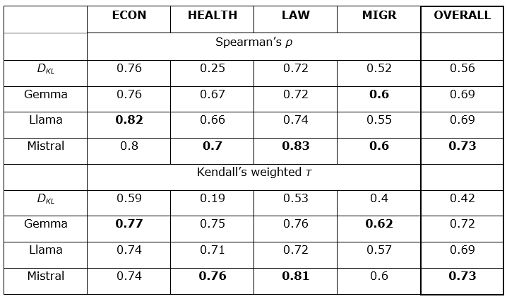
Results: correlation with human ranking
Notes:
[text]

Slide 49
Results: summary
DKL baseline scores are consistently outperformed by GenAI models
Moderate to high correlation (0.6 – 0.83 for Spearman’s ρ)
Small open-source models!
Mistral performs best
Notes:
[text]

Slide 50
Results: Interpretation
Statistical keyness metrics based on word frequencies are a legitimate method to create rudimentary domain-specific word lists for L2 learning purposes
GenAI models take this a considerable step further and provide keyword rankings that resemble human intuitions relatively well
Notes:
[text]

Slide 51
Conclusion
Notes:
[text]

Slide 52
Contributions
Publicly available “gold-standard” data: human ranking of 200-item vocabulary lists (totalling 4,800 annotations)
First-of-its-kind empirical evidence into:
Correlation between human ranking and statistical keyness measure (DKL)
Correlation between human ranking and GenAI-based ranking
Prompting: asking to compare items seems to work well
Notes:
[text]

Slide 53
Limitations (dataset)
Limited numbers of topics
Limited number of target items per topic
Notes:
[text]

Slide 54
Limitations (modelS)
Results not fully replicable → more research needed to corroborate findings
Environmental cost GenAI > environmental cost statistical keyness measures (although impact of small models should be reasonable)
Average correlation of 0.73 → still room for improvement
Notes:
[text]

Slide 55
REferences
Flynn, T. N., & Marley, A. A. J. (2014). Best-worst scaling: Theory and methods. In S. Hess & A. Daly (Eds.), Handbook of Choice Modelling. Edward Elgar Publishing. https://doi.org/10.4337/9781781003152.00014
Gries, S. Th. (2021). A new approach to (key) keywords analysis: Using frequency, and now also dispersion. Research in Corpus Linguistics, 9(2), 1–33. https://doi.org/10.32714/ricl.09.02.02
Notes:
[text]

Slide 56





Jasper Degraeuwe Postdoctoral researcher Department of translation, interpreting and communication Jasper.Degraeuwe@UGent.be www.ugent.be
Universiteit Gent @ugent
@ugent Ghent University
Dataset →
Slides →
Notes:
And then I just want to thank you very much for your attention!

